Slide 1


Slide 2
Those who listen to the word and follow the best thereof, those are whom Allah has guided and those are men of understanding
39:18
Notes:
Leader is guide. He should be himself a guided person

Slide 3
What do you know about leadership?

Slide 4
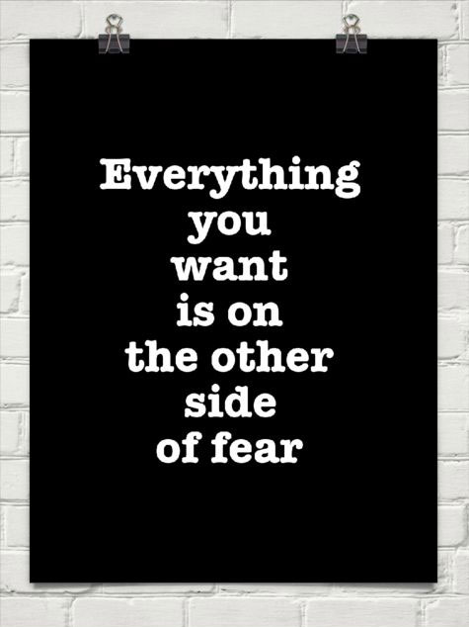

Slide 5
FEAR THE FEAR ONLY
Notes:
A leader has to be fearless. Takes risks.
He has to be at the front, where the opposition/problem is
Nobody would like to follow a coward person

Slide 6
Leadership
Leadership
Theory and Practice, 8th/e
Peter G. Northouse, Ph.D.

Slide 7
Overview
Conceptualizing Leadership
Components of the Definition
Leadership Definition
Followers & Leaders
Notes:
Before we proceed let me know the names of some famous leaders you are impressed with or you like them……. They may give names from military.

Slide 8
INTRODUCTION
Leadership matters
Success in work life and daily life
Company’s prefer good leaders
Leadership programmes in academic institutions
Lot of studies on leadership
Notes:
Most sought after subject.
People learn about leadership to become successful in life
Organizations seek people with leadership qualities
Educational institutes responded by more and more leadership courses
People take a simplistic view, but is not that simple. Sophisticated and complex phenomenon.

Slide 9
Conceptualizing Leadership
LEADERSHIP CONCEPT EVOLVED AS PER FOLLOWING PERSPECTIVES
Great man Theory
A personality perspective
An act or behavior
In terms of the power relationship between leaders & followers
Skills Perspective
transformational process
Notes:
In 60 yrs 65 classification systems have been developed to define the dimensions of leadership
1. Only king’s son can be a king – up to 1930
2. Personality perspective suggests that leadership is a combination of special traits or characteristics that some individuals possess. These traits enable those individuals to induce others to accomplish tasks. – after 1930
3. Act or a behavior—the things leaders do to bring about change in a group.-1940
4. Power perspective syas Leaders have power that they wield to effect change in others.
5. Skills viewpoint stresses the capabilities (knowledge and skills) that make effective leadership possible.
6. Leadership as a transformational process that moves followers to accomplish more than is usually expected of them.

Slide 10
COMPONENTS OF LEADERSHIP
Leadership is a process,
Leadership involves influence
Leadership occurs in groups
Leadership involves common goals.
Notes:
Defining leadership as a process means that it is not a trait or characteristic that resides in the leader, but rather a transactional event that occurs between the leader and the followers. Process implies that a leader affects and is affected by followers. It emphasizes that leadership is not a linear, one-way event, but rather an interactive event. When leadership is defined in this manner, it becomes available to everyone. It is not restricted to the formally designated leader in a group.

Slide 11
COMPONENTS OF LEADERSHIP
Leadership is a process,
Leadership involves influence
Leadership occurs in groups
Leadership involves common goals.
Notes:
Leadership involves influence. It is concerned with how the leader affects followers. Influence is the sine qua non of leadership. Without influence, leadership does not exist.

Slide 12
COMPONENTS OF LEADERSHIP
Leadership is a process,
Leadership involves influence
Leadership occurs in groups
Leadership involves common goals.
Notes:
Others (a group) are required for leadership to occur.

Slide 13
COMPONENTS OF LEADERSHIP
Leadership is a process,
Leadership involves influence
Leadership occurs in groups
Leadership involves common goals.
Notes:
Leadership includes attention to common goals. Leaders direct their energies toward individuals who are trying to achieve something together. By common, we mean that the leaders and followers have a mutual purpose. Attention to common goals gives leadership an ethical overtone because it is the interest of every one.

Slide 14
Leadership Defined
( Can you now try to define leadership according to these components)
Leadership
is a process whereby an individual influences a group of individuals to achieve a common goal.
Notes:
There are as many definitions as number of people who tried to define it like words democracy love and peace.
Rost (1991) analyzed materials written from 1900 to 1990, finding more than 200 different definitions for leadership.
Viewed differently during different time periods. In 21st century the scholars agreed on one thing that they can’t come up with a common definition for leadership.

Slide 15
THANK YOU
ANY QUESTION?
QUIZ IN NEXT CLASS

